Slide 1
Overview of BC Hydro Proposed 2021 UBC Capstone Project #52 Personal Electro-Magnetic Field (EMF) Monitoring Device

Slide 2
Background
BC Hydro’s Material Management Business Unit (MMBU) is building on building a permanent Material Classification Facility (MCF) on an existing BC Hydro Right of Way, which be under an existing double circuit 230 kV line, and a second double circuit 230 kV line in the distant future.
Exposure to EMF is one of the concerns of the BC Hydro staff working in this new facility.
The levels of EMF have been shown to be low and acceptable via classic calculation methods.
However, to provide the MCF workers with more peace of mind it has been suggested that each individual who works in the MCF should carry a personal EMF monitor with a visual indication of the level of both electric and magnetic fields database should be Excel based.

Slide 3
Background con’t
A feasibility design effort was undertaken by a BCIT Capstone Team in 2020, and this effort is documented in the BC Hydro report, but no working proto-type was demonstrated to BC Hydro, and no field testing undertaken.
Both the overall risk assessment report and the BCIT report will be provided.
No project funding has been confirmed at this time.

Slide 4
Review of Scope of Project
The main objectives of this project are:
to create a working proto-type personal (EMF) monitoring device and data logging, plus analysis system for up to 3 individuals with this system being expandable to handle up 20 individuals as required, in the future.
Field testing of the proto-type device and documented the results is part of the scope of this project.
Creation of a project report.

Slide 5
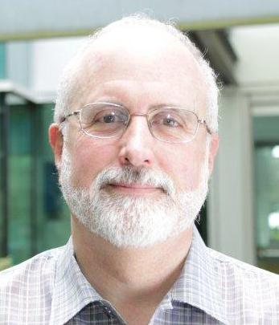
BC Hydro Project Support Personnel
BC Hydro Capstone Coordinator
Bob Stewart, P. Eng.
Principal Engineer - Generating Stations Engineering
BC Hydro - Integrated Planning

Slide 6
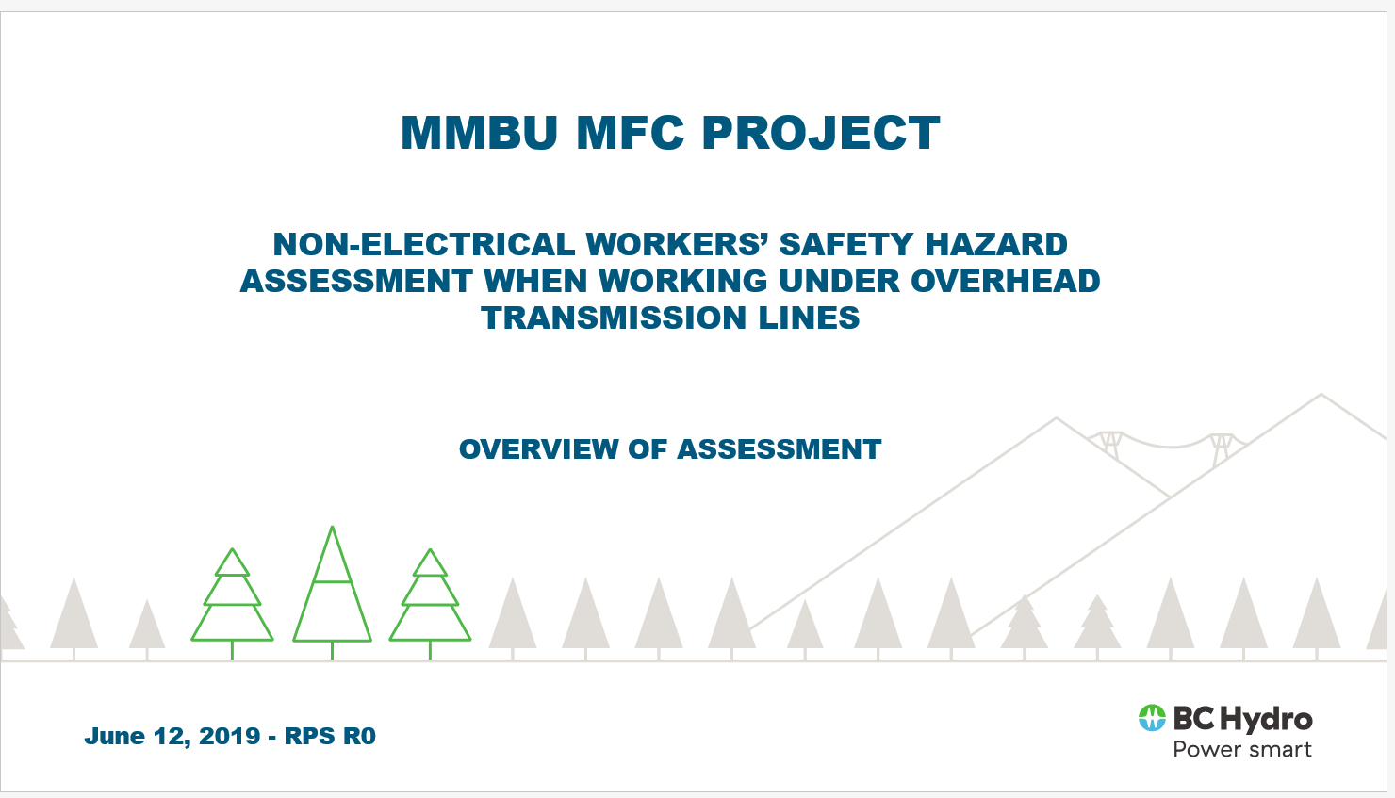
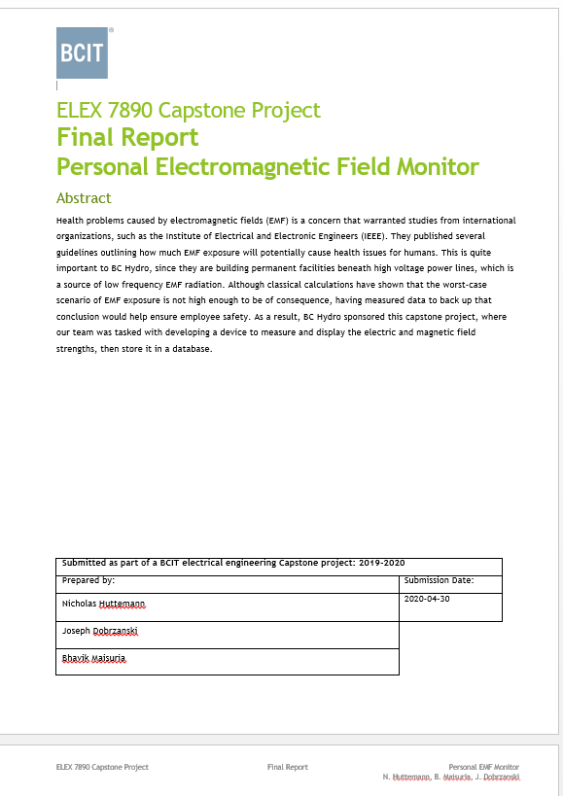
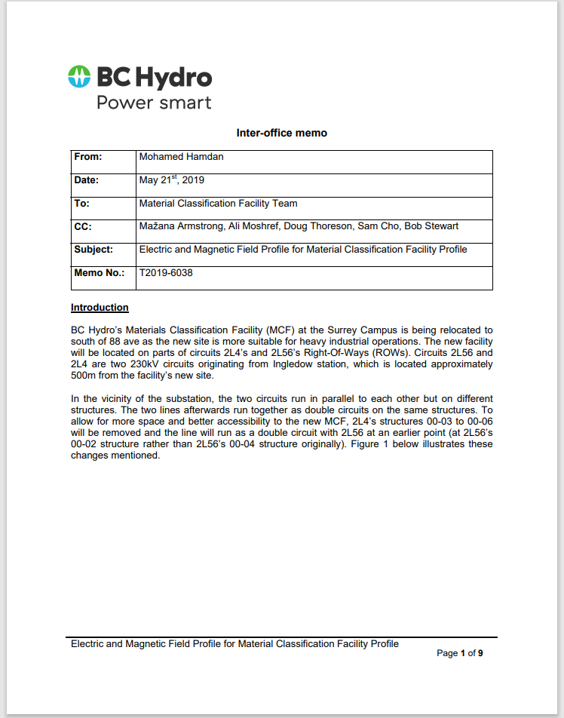
Additional Project Information con’t

Slide 7
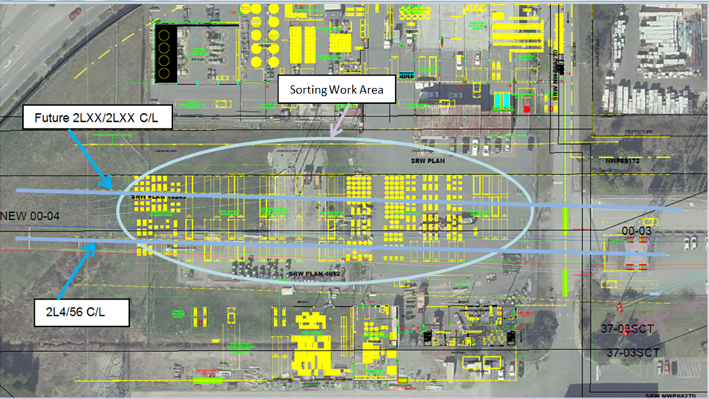
Additional Project Information con’t

Slide 8

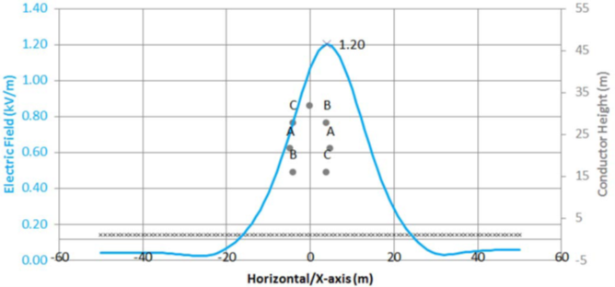
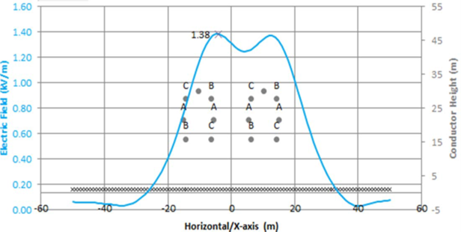
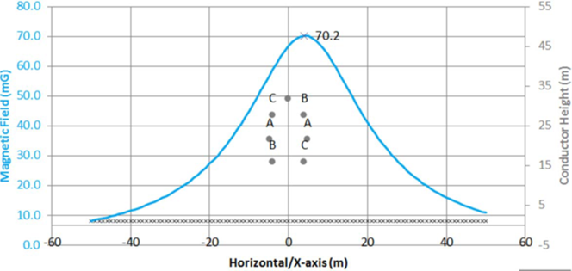
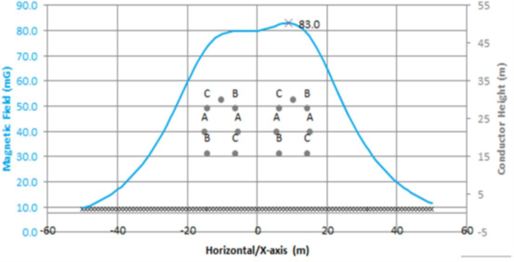
Additional Project Information con’t

Slide 9
Question and Answer Session

